Slide 1


Complex Variable, Laplace & Z- transformation
Lecture 02

Slide 2

This Lecture Covers -
1. Laplace Transformation Using First Shifting Property.
2. Some Examples & Exercises on First Shifting Property.
3. Laplace Transformation Using Multiplication by $t^{n}$ Property.
4. Some Examples & Exercises on Multiplication by $t^{n}$Property.

Slide 3



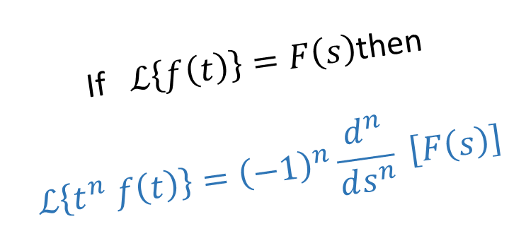

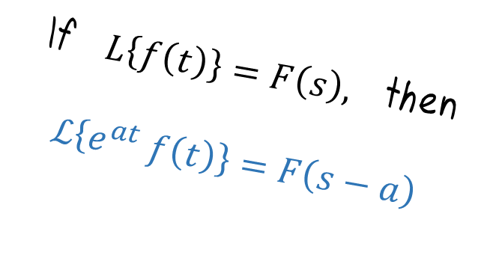
First Shifting or Translation Property
Property of Multiplication by ${\text{t}}^{\text{n}}$
If $L\left\{f\left(t\right)\right\}=F\left(s\right),$ then
$ℒ\left\{e^{at} f\left(t\right)\right\}=F\left(s−a\right)$
If $ℒ\left\{f\left(t\right)\right\}=F\left(s\right)$then
$$ℒ\left\{t^{n} f\left(t\right)\right\}={\left(−1\right)}^{n}\frac{d^{n}}{ds^{n}} \left[F\left(s\right)\right]$$

Slide 4
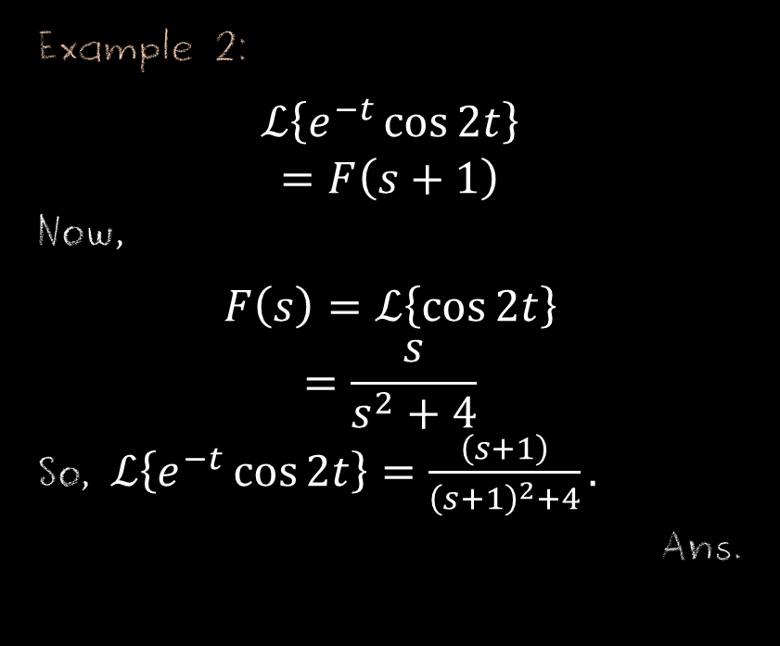

Examples on Shifting Property
Example 1:
$$ℒ\left\{e^{2t}\sin{t}\right\}$$
$$=F\left(s−2\right)$$
Now,
$$F\left(s\right)=ℒ\left\{\sin{t}\right\}$$
$$=\frac{1}{s^{2}+1}$$
So, $ℒ\left\{e^{2t}\sin{t}\right\}=\frac{1}{{\left(s−2\right)}^{2}+1}.$
Ans.
Example 2:
$$ℒ\left\{e^{−t}\cos{2t}\right\}$$
$=F\left(s+1\right)$
Now,
$$F\left(s\right)=ℒ\left\{\cos{2t}\right\}$$
$$=\frac{s}{s^{2}+4}$$
So, $ℒ\left\{e^{−t}\cos{2t}\right\}=\frac{\left(s+1\right)}{{\left(s+1\right)}^{2}+4}.$
Ans.

Slide 5
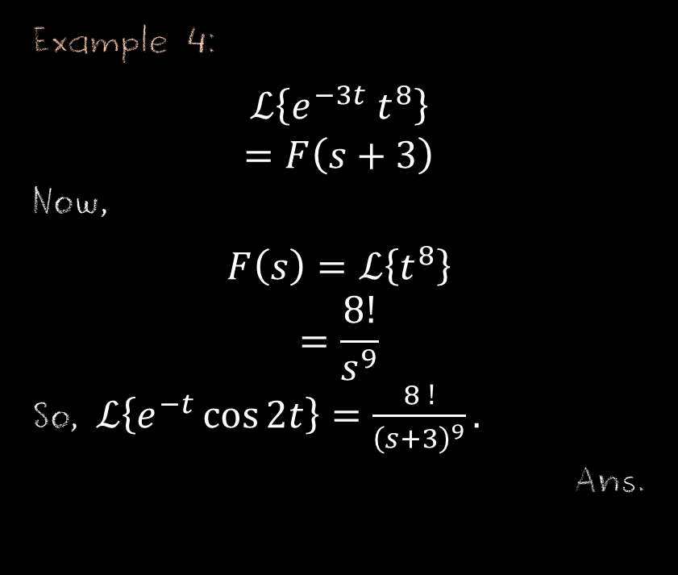
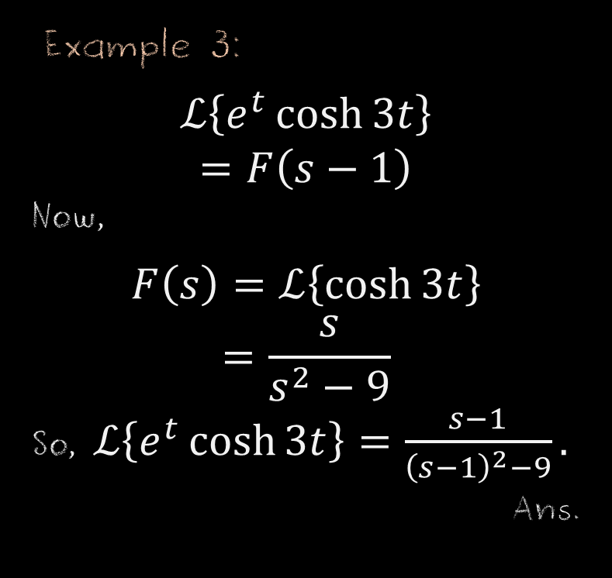
Examples on Shifting Property
Example 3:
$$ℒ\left\{e^{t}\cosh{3t}\right\}$$
$$=F\left(s−1\right)$$
Now,
$$F\left(s\right)=ℒ\left\{\cosh{3t}\right\}$$
$$=\frac{s}{s^{2}−9}$$
So, $ℒ\left\{e^{t}\cosh{3t}\right\}=\frac{s−1}{{\left(s−1\right)}^{2}−9}.$
Ans.
Example 4:
$$ℒ\left\{e^{−3t} t^{8}\right\}$$
$=F\left(s+3\right)$
Now,
$$F\left(s\right)=ℒ\left\{t^{8}\right\}$$
$$=\frac{8!}{s^{9}}$$
So, $ℒ\left\{e^{−t}\cos{2t}\right\}=\frac{8 !}{{\left(s+3\right)}^{9}}.$
Ans.

Slide 6

Exercise Set on Shifting Property
Find Laplace Transformation of the following function:
1. $f\left(t\right)=e^{2t}\sinh{3t,}$
2. $f\left(t\right)=e^{−t}\sinh{4t},$
3. $f\left(t\right)=e^{2t}\cos{3t,}$
4. $f\left(t\right)=t^{10} e^{−7t},$
5. $f\left(t\right)=e^{5t}\cosh{6t}$.

Slide 7



Examples on Multiplication by $t^{n}$ Property
Example 1 :
$$ℒ\left\{t\cos{t}\right\}={\left(−1\right)}^{1}\frac{d}{ds}\left[F\left(s\right)\right] \\ =−\frac{d}{ds} \left[ℒ\left\{\cos{t}\right\}\right] \\ =−\frac{d}{ds} \left[\frac{s}{s^{2}+1}\right] \\ =− \frac{\left(s^{2}+1\right)\frac{d}{ds} \left(s\right)−s\frac{d}{ds}\left(s^{2}+1\right)}{{\left(s^{2}+1\right)}^{2}} \\ = − \frac{\left(s^{2}+1\right)−s×2s}{{\left(s^{2}+1\right)}^{2}} \\ = − \frac{s^{2}+1 −2s^{2}}{{\left(s^{2}+1\right)}^{2}} \\ = \frac{s^{2}−1}{{\left(s^{2}+1\right)}^{2}}.$$
Ans.
Example 2 :
$$ℒ\left\{t^{2} e^{3t}\right\}={\left(−1\right)}^{2}\frac{d^{2}}{ds^{2}}\left[F\left(s\right)\right] \\ =\frac{d^{2}}{ds^{2}} \left[ℒ\left\{e^{3t}\right\}\right] \\ =\frac{d^{2}}{ds^{2}} \left[\frac{1}{s−3}\right] \\ =\frac{d}{ds}\left[\frac{\left(s−3\right)\frac{d}{ds} \left(1\right)−1\frac{d}{ds}\left(s−3\right)}{{\left(s−3\right)}^{2}}\right] \\ = \frac{d}{ds} \left[\frac{−1}{{\left(s−3\right)}^{2}}\right] \\ = \left(−1\right) \left(−2\right){\left(s−3\right)}^{−3} \\ = \frac{2}{{\left(s−3\right)}^{3}}.$$
Ans.

Slide 8

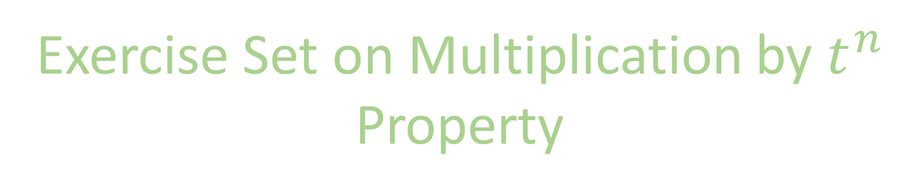
Exercise Set on Multiplication by $t^{n}$ Property
Find Laplace Transformation of the following functions:
1.$f\left(t\right)=t\sin{2t},$
2. $f\left(t\right)=t\cos{bt},$
3. $f\left(t\right)=t^{2} e^{−4t},$
4. $f\left(t\right)=t\sinh{3t,}$
5. $f\left(t\right)=t\cosh{2t.}$

Slide 9
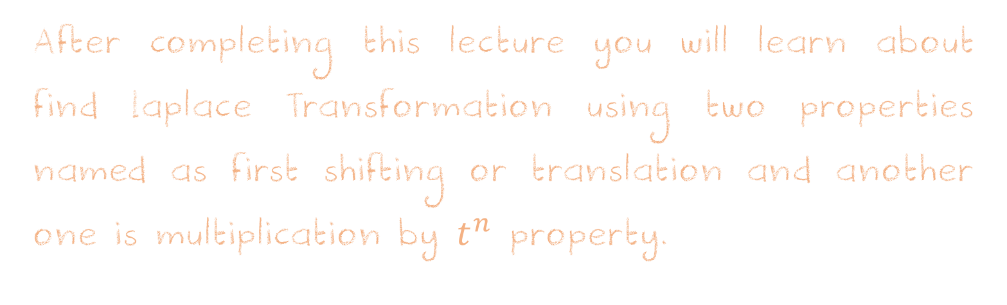
Learning Outcomes
After completing this lecture you will learn about find Laplace Transformation using two properties named as first shifting or translation and another one is multiplication by $t^{n}$ property.

Slide 10












Sample MCQ
1. $ℒ\left\{t^{10} e^{−5t}\right\}=?$
(a)$\frac{11 !}{{\left(s+5\right)}^{10}}$
(b)$\frac{10 !}{{\left(s+5\right)}^{11}}$
(c)$\frac{10 }{{\left(s+5\right)}^{11}}$
(d)$\frac{10 !}{{\left(s+5\right)}^{10}}$
2. $ℒ\left\{t\sin{t}\right\}=?$
(a) $\frac{2s}{{\left(s^{2}+1\right)}^{2}}$
(b) $\frac{s}{{\left(s^{2}+1\right)}^{2}}$
(c) $\frac{4s}{{\left(s^{2}+1\right)}^{2}}$
(d) $\frac{4s}{{\left(s^{2}−1\right)}^{2}}$
3. $ℒ\left\{e^{3t}\cosh{5t}\right\}=?$
(a)$\frac{s}{s^{2}+25}$
(b)$\frac{s+3}{{\left(s+3\right)}^{2}+25}$
(c)$\frac{s+3}{{\left(s+3\right)}^{2} −25}$
(d)$\frac{s−3}{{\left(s−3\right)}^{2} −25}$

Slide 11




Sample MCQ
4. $ℒ\left\{e^{2t}\sinh{t}\right\}=?$
(a)$\frac{2}{{\left(s−1\right)}^{2}−1}$
(b)$\frac{1}{{\left(s−2\right)}^{2}−1}$
(c)$\frac{1}{{\left(s+2\right)}^{2}−1}$
(d) none
5. $ℒ\left\{t\cos{t}\right\}=?$
(a) $\frac{2s}{{\left(s^{2}+1\right)}^{2}}$
(b) $\frac{s^{2}−1}{{\left(s^{2}+1\right)}^{2}}$
(c) $\frac{4s}{{\left(s^{2}+1\right)}^{2}}$
(d) $\frac{4s}{{\left(s^{2}−1\right)}^{2}}$

